Slide 1
Accessory Dwelling Units Rowe Planning Board - Informational Meeting 11/14/24
What the Law Says
Potential Impacts
Conflicting Bylaws
Questions/Concerns

Slide 2
New Law – HB4977
- Defines Accessory Dwelling Unit:
“Accessory dwelling unit”, a self-contained housing unit, inclusive of sleeping, cooking and sanitary facilities on the same lot as a principal dwelling, subject to otherwise applicable dimensional and parking requirements, that: (i) maintains a separate entrance, either directly from the outside or through an entry hall or corridor shared with the principal dwelling sufficient to meet the requirements of the state building code for safe egress; (ii) is not larger in gross floor area than 1/2 the gross floor area of the principal dwelling or 900 square feet, whichever is smaller; and (iii) is subject to such additional restrictions as may be imposed by a municipality, including, but not limited to, additional size restrictions and restrictions or prohibitions on short-term rental, as defined in section 1 of chapter 64G; provided, however, that no municipality shall unreasonably restrict the creation or rental of an accessory dwelling unit that is not a short-term rental.
- Describes some Reasonable Regulations:
“No zoning ordinance or by-law shall prohibit, unreasonably restrict or require a special permit or other discretionary zoning approval for the use of land or structures for a single accessory dwelling unit, or the rental thereof, in a single-family residential zoning district; provided, that the use of land or structures for such accessory dwelling unit under this paragraph may be subject to reasonable regulations, including, but not limited to, 310 CMR 15.000 et seq., if applicable, site plan review, regulations concerning dimensional setbacks and the bulk and height of structures and may be subject to restrictions and prohibitions on short-term rental, as defined in section 1 of chapter 64G. The use of land or structures for an accessory dwelling unit under this paragraph shall not require owner occupancy of either the accessory dwelling unit or the principal dwelling; provided, that not more than 1 additional parking space shall be required for an accessory dwelling unit; and provided further, that no additional parking space shall be required for an accessory dwelling located not more than 0.5 miles from a commuter rail station, subway station, ferry terminal or bus station. For more than 1 accessory dwelling unit, or rental thereof, in a single-family residential zoning district there shall be a special permit for the use of land or structures for an accessory dwelling unit. The executive office of housing and livable communities may issue guidelines or promulgate regulations to administer this paragraph.”

Slide 3
Potential Impacts
Increased Housing/Long Term Rental Options
Age-in-Place Options
Revenue Options for Property Owners – Short or Long Term Rentals
Increased Tax Revenue for Town (would be a very small percentage based on Industrial/Residential Tax ratio)
Disruption or Protection of Open Space depending on wording of bylaws
Potential for strain on municipal services depending on growth

Slide 4
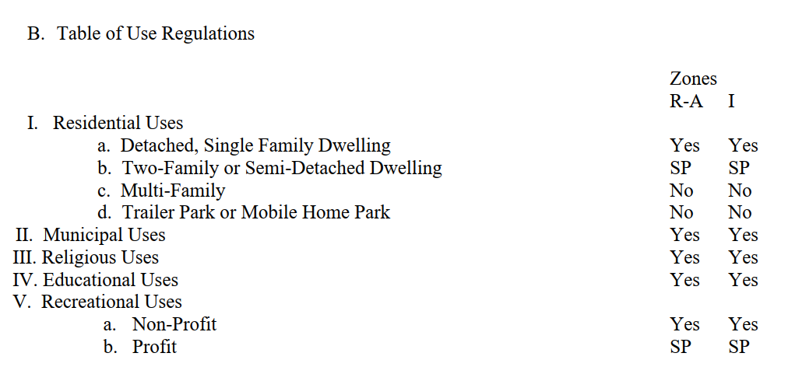
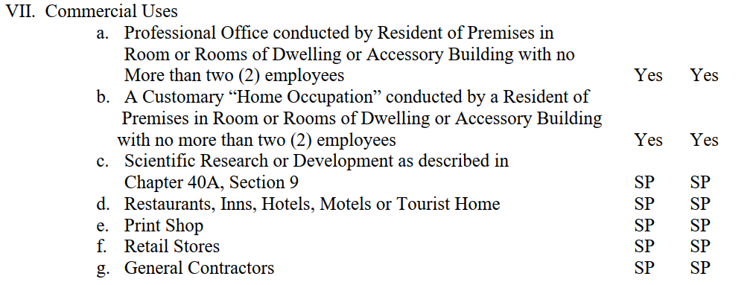
Current Bylaws Potential Conflict
If under 900sf, allowed by right (no special permit)
Multiple ADUs may be allowed by Special Permit
Use of an ADU for Short Term Rental should be better indicated whether by-right, special permit, or prohibited

Slide 5
Current Bylaws Potential Conflict
“No zoning ordinance or by-law shall prohibit, unreasonably restrict or require a special permit or other discretionary zoning approval for the use of land or structures for a single accessory dwelling unit, or the rental thereof, in a single-family residential zoning district;..”
See Definition of Accessory Dwelling Unit in Section 7 of Law
“The use of land or structures for an accessory dwelling unit under this paragraph shall not require owner occupancy of either the accessory dwelling unit or the principal dwelling;..”
This section may also be generally unenforceable
Non-conforming lots may have some protection under the new law to allow a dwelling up to 1850 square feet – **still under review**

Slide 6
Questions or Concerns
Populate with any questions received ahead of time

