Slide 1



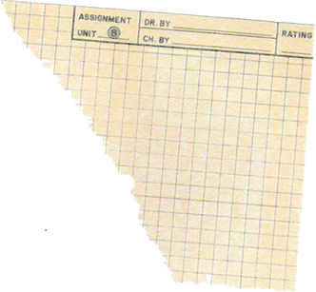

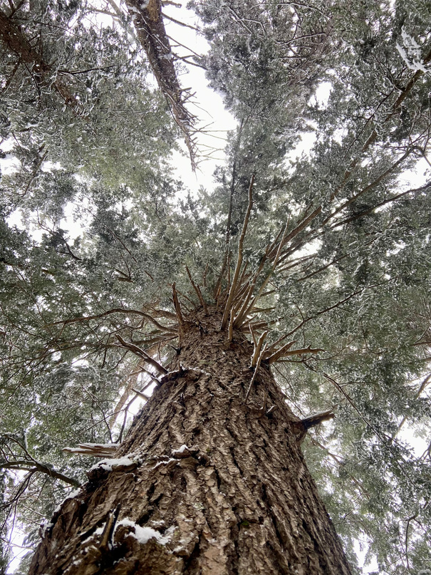

Visit Us
85 Pond Road
Parking Passes for new residents available for pickup Monday through Friday
413-339-5520 ext. 110
parkmanager@rowe-ma.gov
rowe-ma.gov/p/49/Pelham-Lake-Park
Established 1955
In December 1955, Percy W. Brown, a longtime summer resident, gave to the town most of his real estate, comprising some 485 acres, to be maintained as a town forest, public park and recreational area, which includes Pelham Lake and Dam, most of Adams mountain, and the Mill Pond in the village.
Welcome to Rowe!

Slide 2
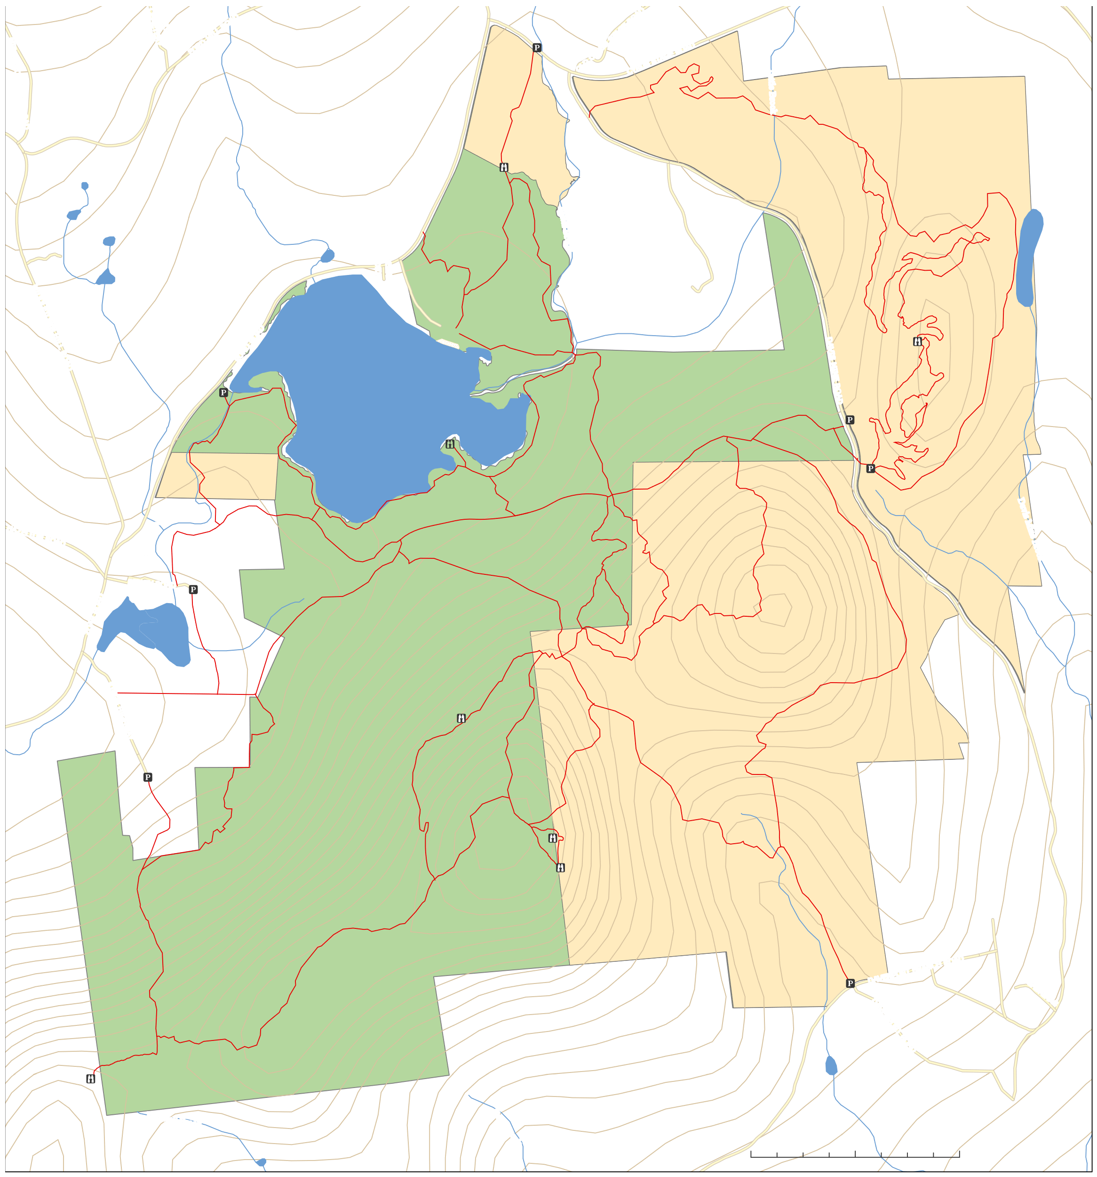

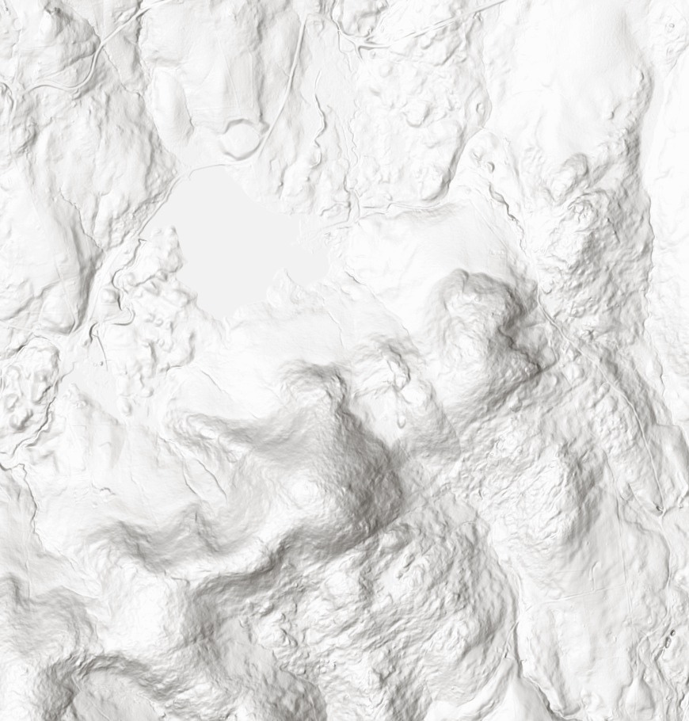
1
6
5
0
f
t
.
1650 ft.
NORTH CEMETERY ROAD
DELL ROAD
Pelham
1590 ft.
Explore the Outdoors
.
FORD HILL ROAD
OLD CYRUS STAGE ROAD
1620 ft.
1620 ft.
0
f
t
Riding Ring
CYRUS STAGE ROAD
6
5
1
MIDDLETOWN HILL ROAD
Lake Park
Tuttle Brook
1530 ft.
Trail
v
s
Mine
L
oo
p
Tr
ail
1590 ft.
Meadow
D
ai
D
Over 1400 acres of Natural Beauty
a
Ba
1500 ft.
vi
b
s
M
in
rail
1.9
blin
e
e
Ten
0.6
Potter Brook
Dd
L
oop
T
B
ao
n
i
r
M
1620 ft.
i
a
o
T
o
s
Trl
g
o
1650 ft.
C
ou
r
t
Tr
k
s
PELHAM DRIVE
0.2
a
il
w
r
e
do
a
Percy Point
i
o
ea
l
Nh
M
r
0.4
r
t
1680 ft.
Tail
MIDDLETOWN HILL ROAD
POND ROAD
B
eac
h
Trail
1.3
Pelham Lake Park offers residents a wide range of recreational opportunities year-round. Whether you enjoy hiking, biking, snowshoeing, cross-country skiing, or horseback riding, the park boasts over 20 miles of trails to explore. The serene Pelham Lake is perfect for swimming and kayaking, with kayaks available for residents to borrow. The park also features tennis and pickleball courts for some friendly competition, and for indoor activities, the fitness center at Town Hall is available as well.
We hope you take full advantage of everything Pelham Lake Park has to offer—a space for relaxation, recreation, and connection with nature, right here in Rowe.
0.5
DAVIS MINE ROAD
Rob’s View 1757 ft
0.4
0.8
La
i
e
w
Trail
ke
Pelham Lake
1470 ft.
V
V
Rob’s
South
ie
0.5
w
il
B
Trail
Da
0.3
T
a
e
R
ice
r
a
Browning Bench Tool Factory
l
rail
T
a
rin
Moose
vi
Trai
w
c
Sab
s
e
h
1
6
M
Brook
L
ak
e
Vi
Trail
5
0
f
t
.
1620 ft.
Dead
o
e
in
Lp
Pelham
1.1
0.1
1680 ft.
1792
ail
Tr
o
ook
Tr
ail
ke
Vie
w
Trail
Wi
ll
i
a
m
s
Tr
ail
1.0
1530 ft.
S
1710 ft.
0.8
1770 ft.
Trail
ams
L
a
ddl
1740 ft.
il
1.1
Davis Mine Brook
HAZELTON ROAD
ar
lham Br
W
illi
e
a
180
0f
t.
1560 ft.
1590 ft.
B
Tr
oo
n
Pe
Dav
Trail
k
t
enp
o
r
t
T
M
Trail
r
0ft.
Mtn
Clif
a
Todd
SIBLEY ROAD
f
il
144
ms
s
0.3
t.
a
id
0f
0.7
d
e
T
183
ZOAR ROAD
.
A
r
Todd Mtn. Summit 1926 ft
Mill Pond
S
Trail
f
t
a
1860 ft.
o
410
i
Sibley
1
l
ul
e
Tr
ail
0.2
0.2
.
Da
t
v
f
0
en
8
3
p
1
o
Sibley Trail
0.9
1
r
t
T
7
r
ail
7
KINGS HIGHWAY
0
1.3
Tail
f
t
1320 ft.
1350 ft.
tn
r
.
1710 ft.
0.6
M
il
0.3
s
1
8
9
r
a
ew
m
1920 ft.
0
f
t
.
T
1740 ft.
Vi
da
0.5
est
A
1950 ft.
Ridge
1
59
0f
t.
ail
w
1980 ft.
S
Tr
th
o
or
ut
1792 Trail
N
h
w
e
Perch
rn
a
Per c y
B
o
Trail
st
V
Trail
1560 ft.
hit
et
ail
Adams Mtn. Summit 2116 ft
iew
0.2
0.1
O
W
Da
ven
1530 ft.
ld
po
Kings
6
0
f
t
.
rt
t.
H
1
8
Trail
f
i
0
g
0.9
7
4
hway
Trail
1800 ft.
1500 ft.
DAVENPORT BRANCH ROAD
1
1440 ft.
ft.
0
1
0.7
ail
14
et
SABRINAS LANE
W
hit
DAVENPORT ROAD
1830
ft.
1
8
0
0
f
t.
1830 ft.
86
0f
t.
1380 ft.
1
Maxwell Brook
Tatro Brook
1350 ft.
1890 ft.
Map updated April 2003
1
5
0
0
f
t
.
0
500
1,000
2,000US Feet
1320 ft.

